Slide 1

ENVIRONMENTAL TAMPER DETECTION FOR SERVER RACK
PBCST504 – MICROCONTROLLERS
MICRO PROJECT
Zeroth Review

Slide 2
ENVIRONMENTAL TAMPER DETECTION FOR SERVER RACK
Title:- ENVIRONMENTAL TAMPER DETECTION FOR SERVER RACK
Group No:11
Members:
JEC24CC004-ADHIL K B
JEC24CC015-ALWIN C ABHILASH
JEC24CC018-ANGELO T J
JEC24CC031-DEVANANDA SANTHOSH
JEC24CC058-VAISHNAV MANOJ
Project Coordinator:
Ms.Sagna L T
Asst. Prof. CSE(CY)

Slide 3
ENVIRONMENTAL TAMPER DETECTION FOR SERVER RACK
DEPARTMENT OF COMPUTER SCIENCE & ENGINEERING
(Cyber Security)
Vision of the Department
To be a globally recognized centre of excellence in Cyber Security education, research and innovation by nurturing ethical professionals , fostering technological advancement through responsible practice and contributing to a secure and sustainable digital society.

Slide 4
ENVIRONMENTAL TAMPER DETECTION FOR SERVER RACK
DEPARTMENT OF COMPUTER SCIENCE & ENGINEERING
(Cyber Security)
Mission of the Department
M1: Excellence in Education : To provide outcome-based and industry-oriented education by integrating core computer science principles with advanced cybersecurity technologies and practices.
M2: Ethics and Professional Responsibility : To cultivate ethical values, integrity, social responsibility, and secure computing practices for protecting digital assets and strengthening cyber trust.
M3: Research, Innovation, and Entrepreneurship : To promote research, innovation, and entrepreneurial thinking for developing sustainable solutions to emerging cybersecurity challenges.
M4: Holistic and Global Development : To enhance leadership, teamwork, lifelong learning, and global competence through industry collaboration, interdisciplinary activities, and community engagement.

Slide 5
ENVIRONMENTAL TAMPER DETECTION FOR SERVER RACK
Programme Educational Objectives (PEOs)
PEO 1: Graduates will apply strong foundations in computer science and cybersecurity to design, develop, and manage secure and reliable computing systems for industry and society.
PEO 2: Graduates will pursue successful careers as professionals, innovators or entrepreneurs engaged in technology development, deployment or engineering system implementation in industry and society and contribute to the economic growth of the country.
PEO 3: Graduates will demonstrate ethical responsibility, leadership, teamwork, and effective communication while adapting to evolving global technological environments through lifelong learning.

Slide 6
ENVIRONMENTAL TAMPER DETECTION FOR SERVER RACK
Programme Outcomes
Engineering Graduates will be able to:
1. Engineering knowledge: Apply the knowledge of mathematics, science, engineering fundamentals, and an engineering specialization to the solution of complex engineering problems.
2. Problem analysis: Identify, formulate, review research literature, and analyze complex engineering problems reaching substantiated conclusions using first principles of mathematics, natural sciences, and engineering sciences.
3. Design/development of solutions: Design solutions for complex engineering problems and design system components or processes that meet the specified needs with appropriate consideration for the public health and safety, and the cultural, societal, and environmental considerations.
4. Conduct investigations of complex problems: Use research-based knowledge and research methods including design of experiments, analysis and interpretation of data, and synthesis of the information to provide valid conclusions.
5. Modern tool usage: Create, select, and apply appropriate techniques, resources, and modern engineering and IT tools including prediction and modeling to complex engineering activities with an understanding of the limitations.

Slide 7
ENVIRONMENTAL TAMPER DETECTION FOR SERVER RACK
6. The engineer and society: Apply reasoning informed by the contextual knowledge to assess societal, health, safety, legal and cultural issues and the consequent responsibilities relevant to the professional engineering practice.
7. Environment and sustainability: Understand the impact of the professional engineering solutions in societal and environmental contexts, and demonstrate the knowledge of, and need for sustainable development.
8. Ethics: Apply ethical principles and commit to professional ethics and responsibilities and norms of the engineering practice.
9. Individual and team work: Function effectively as an individual, and as a member or leader in diverse teams, and in multidisciplinary settings.
10. Communication: Communicate effectively on complex engineering activities with the engineering community and with society at large, such as, being able to comprehend and write effective reports and design documentation, make effective presentations, and give and receive clear instructions.
11. Project management and finance: Demonstrate knowledge and understanding of the engineering and management principles and apply these to one’s own work, as a member and leader in a team, to manage projects and in multidisciplinary environments. 12. Life-long learning: Recognize the need for, and have the preparation and ability to engage in independent and life-long learning in the broadest context of technological change.

Slide 8
ENVIRONMENTAL TAMPER DETECTION FOR SERVER RACK
Programme Specific Outcomes (PSOs)
On the completion of Computer Science & Engineering program, the students will possess:
PSO 1: Apply cyber security principles to mitigate cyber risk and analyze security requirements of an organization.
PSO 2: Develop and deploy secure software and infrastructure using modern tools and industry standards.
PSO 3: Uphold ethical, legal, and societal responsibilities while protecting privacy, data, and digital assets.

Slide 9
ENVIRONMENTAL TAMPER DETECTION FOR SERVER RACK
CONTENTS
Motivation
Introduction
Problem Statement
Proposed Method
Basic Block Diagram
Conclusion
References

Slide 10
Motivation
ENVIRONMENTAL TAMPER DETECTION FOR SERVER RACK
Server racks require a secure and controlled environment for reliable operation.
Physical tampering, unauthorized access and vibration can damage server equipment.
Traditional monitoring systems may not detect physical threats immediately.
Need for a low-cost, real-time environmental monitoring system.
To improve server security and prevent hardware failures.
To develop a microcontroller-based system that provides instant alerts during abnormal conditions.

Slide 11
Introduction
ENVIRONMENTAL TAMPER DETECTION FOR SERVER RACK
In the digital era, servers play a vital role in storing and processing critical information.
Continuous monitoring is essential to ensure server safety and reliability.
Environmental issues like unauthorized access and physical disturbances can damage server systems.
This project introduces a microcontroller-based system for server rack protection.
The system monitors door access, vibration, and light conditions in real time.
It provides instant alerts during abnormal situations to prevent failures and improve security.

Slide 12
Problem Statement
ENVIRONMENTAL TAMPER DETECTION FOR SERVER RACK
Server racks require continuous monitoring to maintain safe and reliable operation.
Environmental changes such as vibration and unauthorized access can cause server damage.
Existing systems may not provide immediate detection of physical tampering.
A low-cost and efficient monitoring system is needed to identify abnormal conditions.
The project aims to develop a microcontroller-based system that detects environmental threats and provides real-time alerts.

Slide 13
Proposed Method
ENVIRONMENTAL TAMPER DETECTION FOR SERVER RACK
Develop a microcontroller-based tamper detection system using ESP32.
Detect door opening using a Reed Switch.
Detect physical tampering using a Vibration Sensor.
Detect light changes using an LDR.
Process sensor data using ESP32.
Trigger buzzer, LED, and mobile notification.

Slide 14
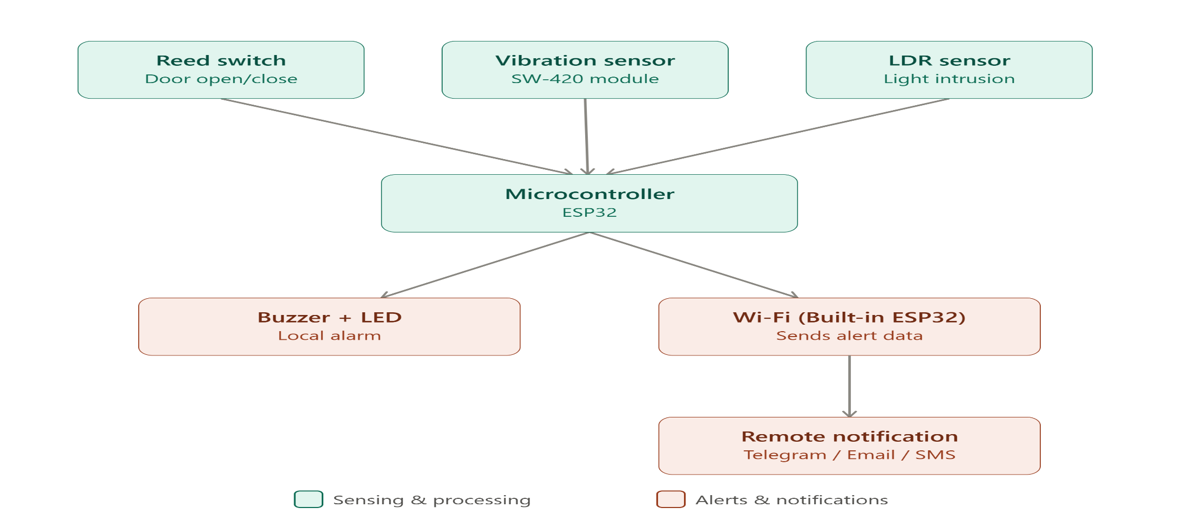
Basic Block Diagram
ENVIRONMENTAL TAMPER DETECTION FOR SERVER RACK

Slide 15
Conclusion
ENVIRONMENTAL TAMPER DETECTION FOR SERVER RACK
Developed a low-cost microcontroller-based tamper detection system.
Detects unauthorized door opening using a Reed Switch.
Detects physical tampering using a Vibration Sensor.
Monitors light changes inside the server rack using a Light Sensor.
Provides real-time alerts during abnormal conditions.
Enhances the security and protection of server racks.

Slide 16
References
ENVIRONMENTAL TAMPER DETECTION FOR SERVER RACK
Espressif Systems – ESP32 Datasheet (https://www.espressif.com)
Arduino – Arduino IDE Documentation (https://www.arduino.cc)
Random Nerd Tutorials – ESP32 Sensor Interfacing (https://randomnerdtutorials.com)
Reed Switch Datasheet
SW-420 Vibration Sensor Datasheet
LDR Datasheet

